Slide 1








On the Film Adaptation of Northanger Abbey
Presentation by : 周咨成、王安瑞

Slide 2
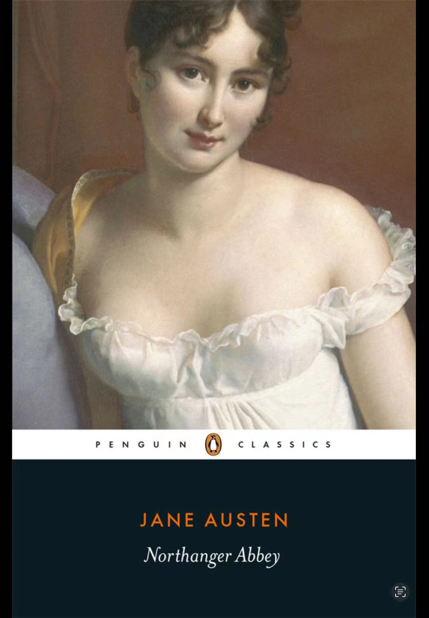
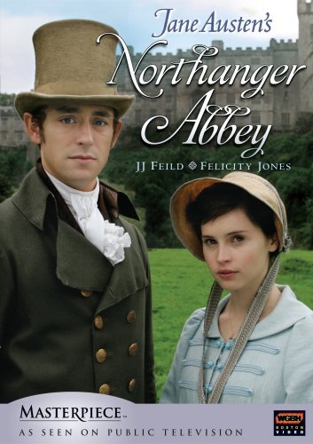
INTRODUCTION

Slide 3
CONTENT
Part 1
Part 2
Catherine Morland in the Film Adaptation :
Conflict Between Fantasy and Reality
Analysis of the Divergent Themes in Movie and Novel

Slide 4
Catherine Morland in the Film Adaptation :
Conflict Between Fantasy and Reality

Slide 5
THE IMAGE OF CATHERINE
Full of imagination
Young and naive
Obsessed with Gothic fiction

Slide 6
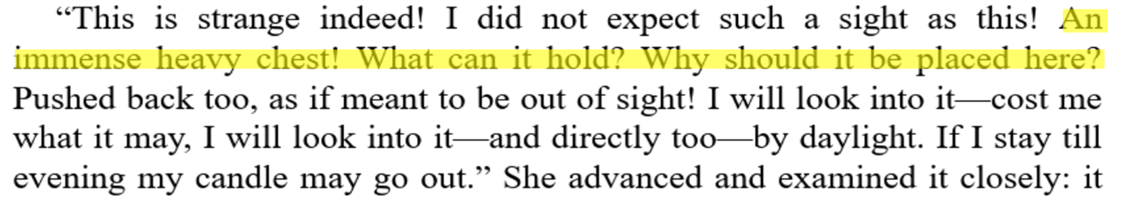
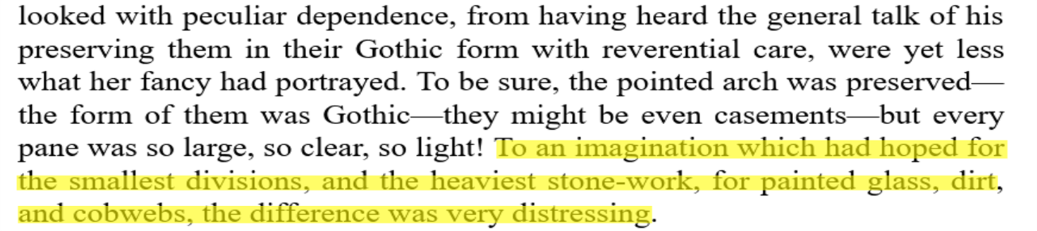
THE IMAGE OF CATHERINE

Slide 7
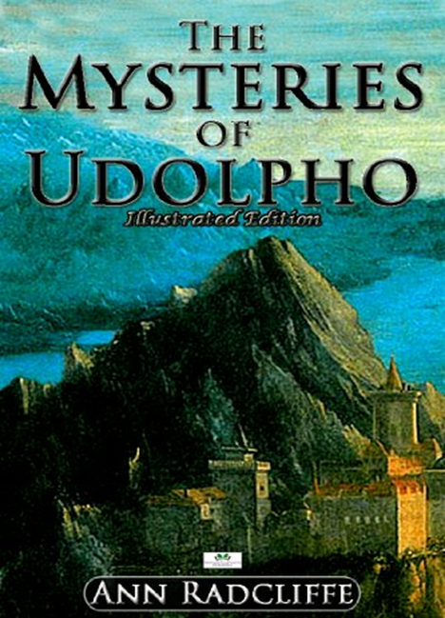

EVALUATIONS OF GOTHIC FICTION AT THE TIME
SAMUEL JOHNSON
JANE AUSTIN
The rational requirement of fiction is the dissemination of truth
Influence readers to explore the world and seek to understand it

Slide 8
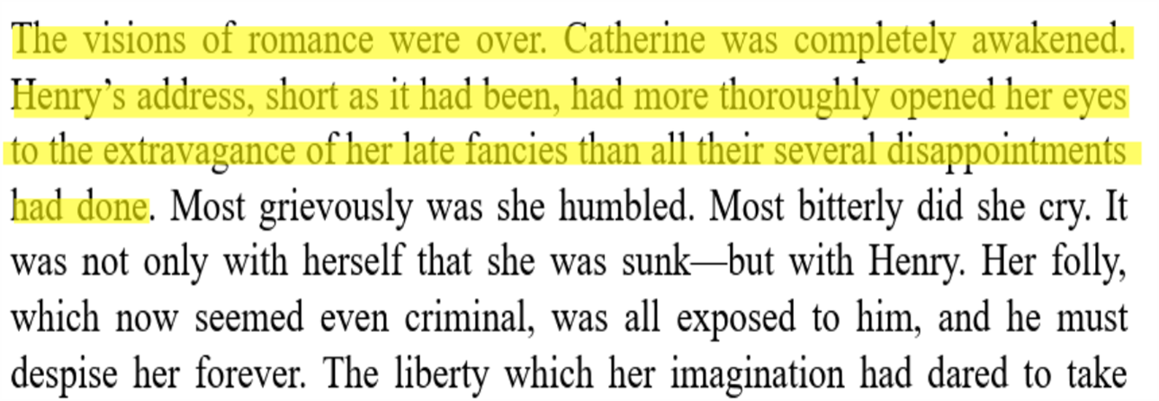
REFLECTION AND GROWTH
illusion shattered
Catherine gained experience from it

Slide 9
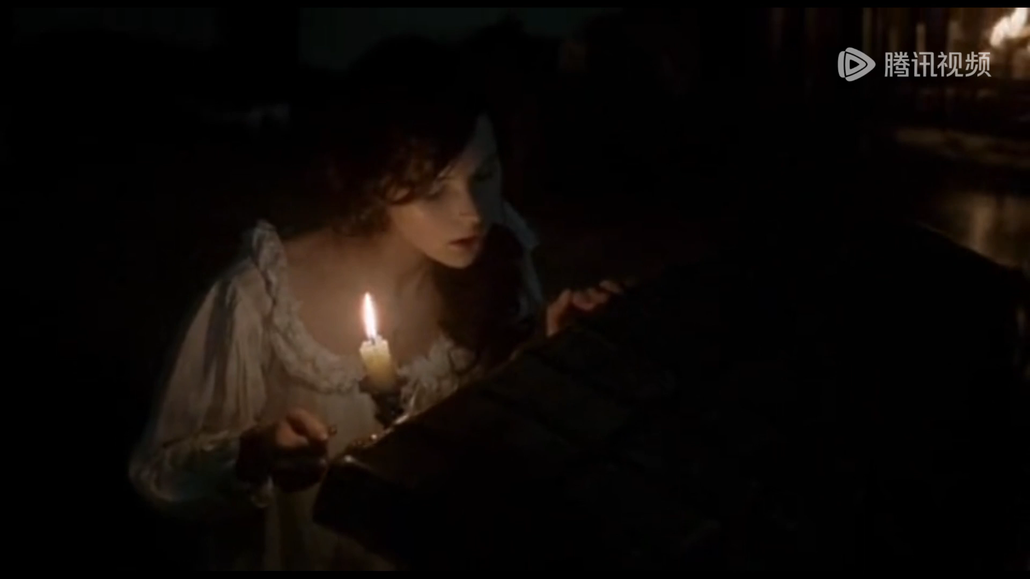
MOVIE'S PORTRAYAL

Slide 10
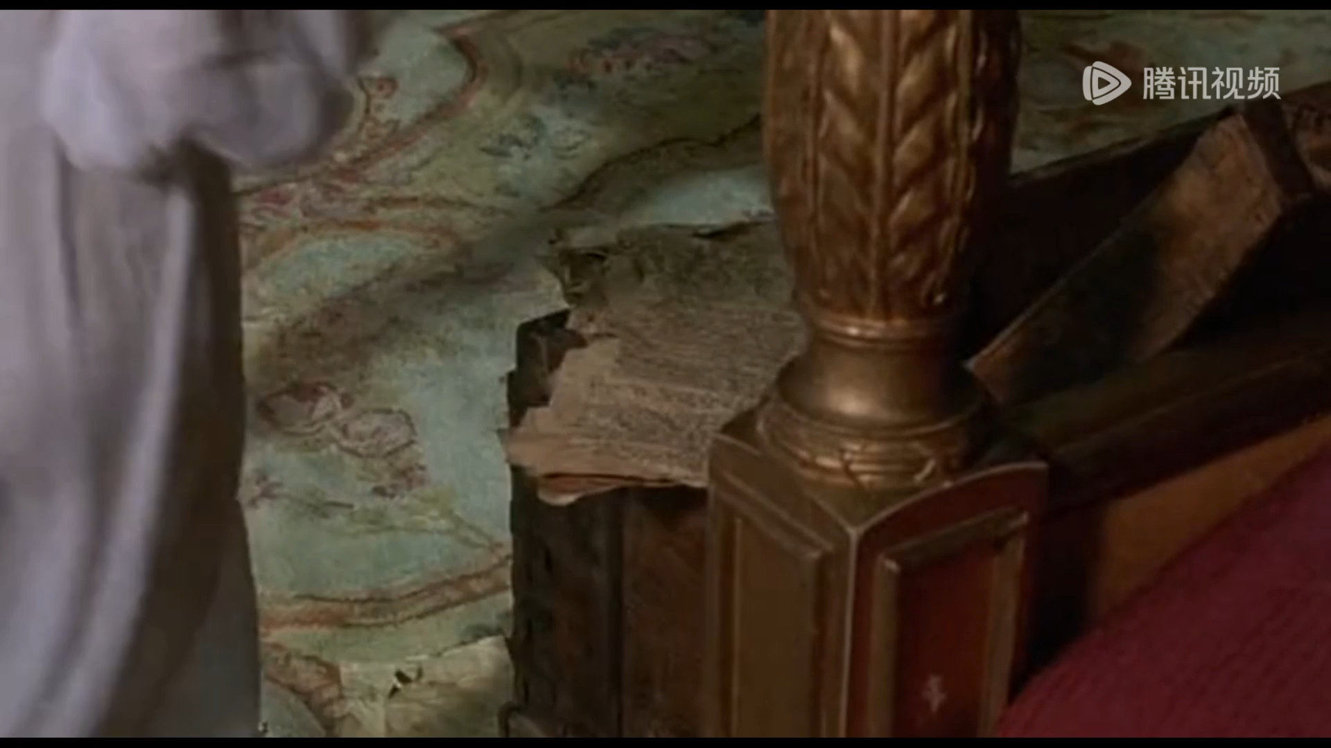
MOVIE'S PORTRAYAL

Slide 11
Analysis of
the Divergent Themes
in Movie and Novel

Slide 12



What Does the Movie Convey?
What Does the Novel Convey?
Summary

Slide 13
What Does the Movie Convey?

Slide 14

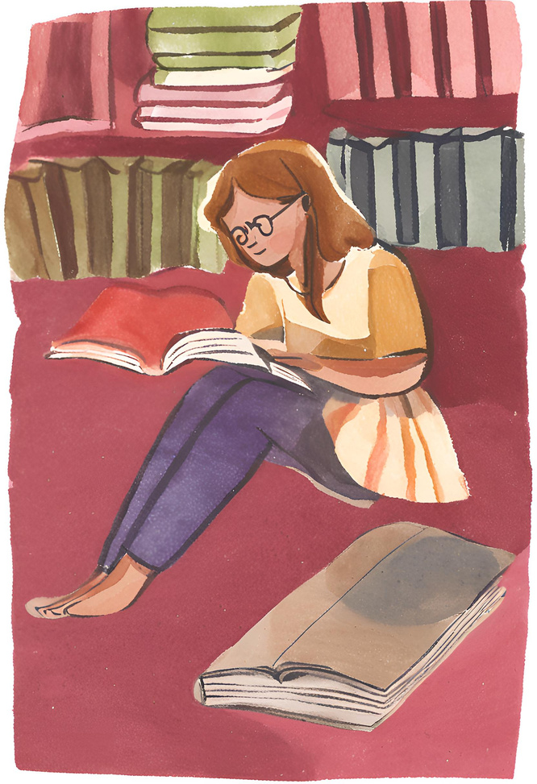
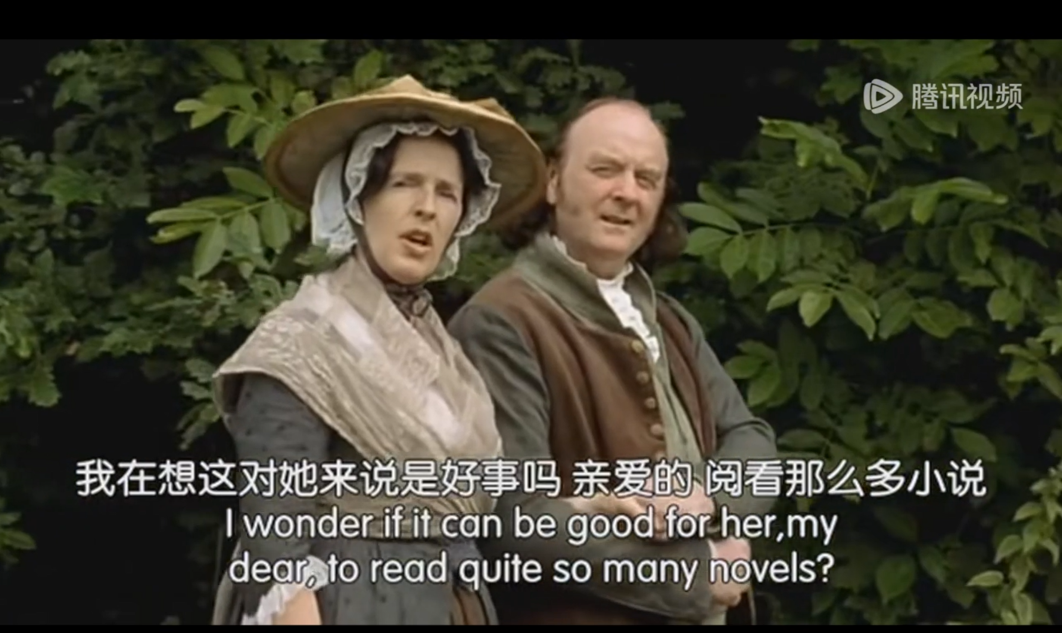
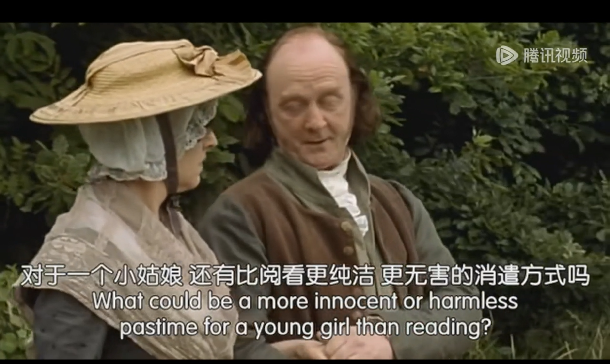
The Impact of Emotional Overindulgence in Arts
Gothic Elements & Dreams and Imagination

Slide 15
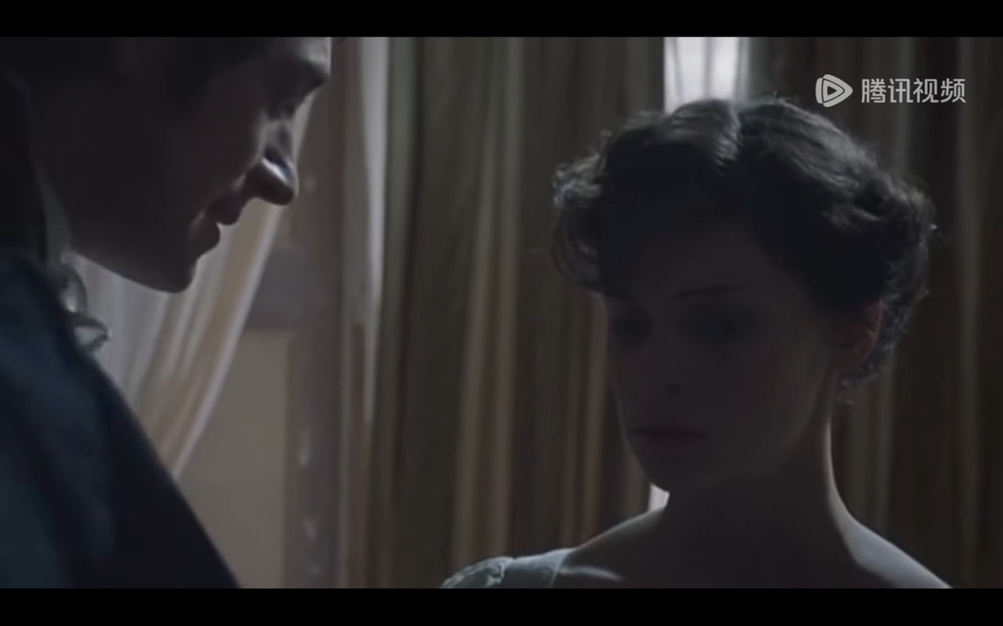
Essential Lessons from Reality
More Direct and Explicit Expression

Slide 16
What Does the Novel Convey?

Slide 17
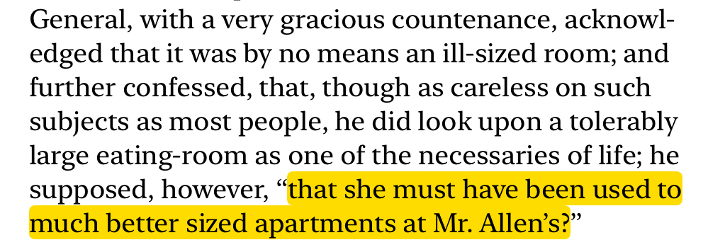
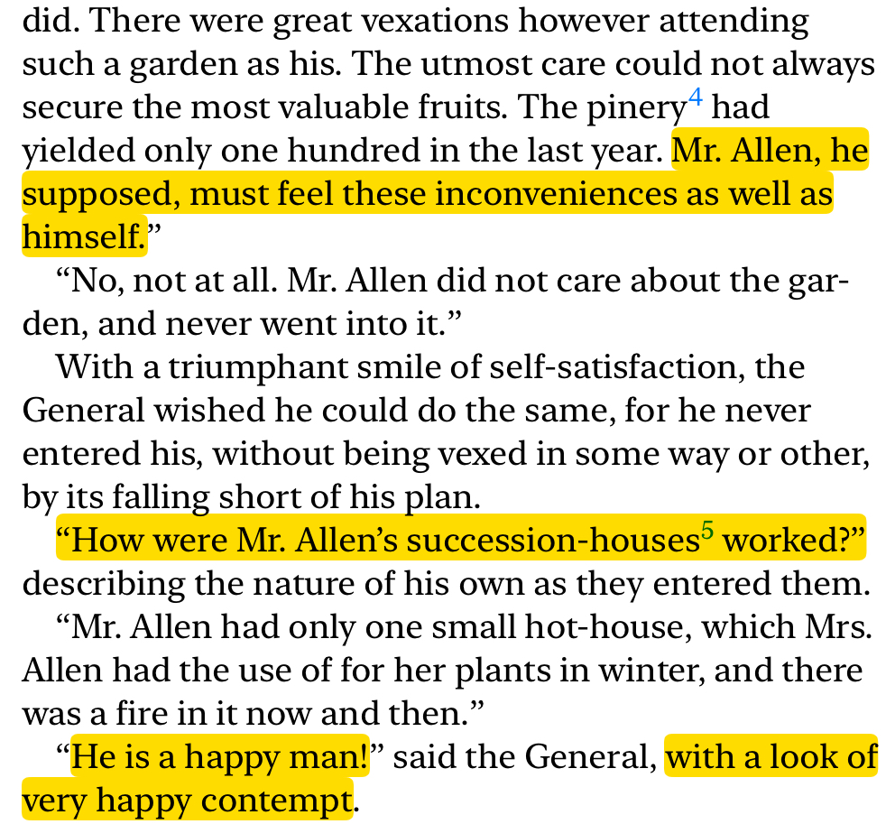

Critique of Marriage Based on Wealth and Status
Is Mr. Allen wealthy?
Is Mr. Allen wealthy?
Is Mr. Allen wealthy?

Slide 18


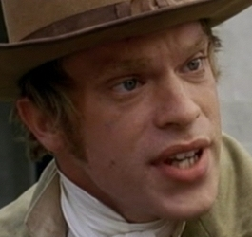
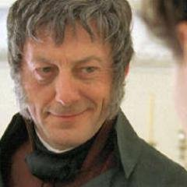

Critique of Marriage Based on Wealth and Status
Wealthy!
Lovely girl!
John Thorpe
General Tilney
Actually poor!
Get out of my house!

Slide 19
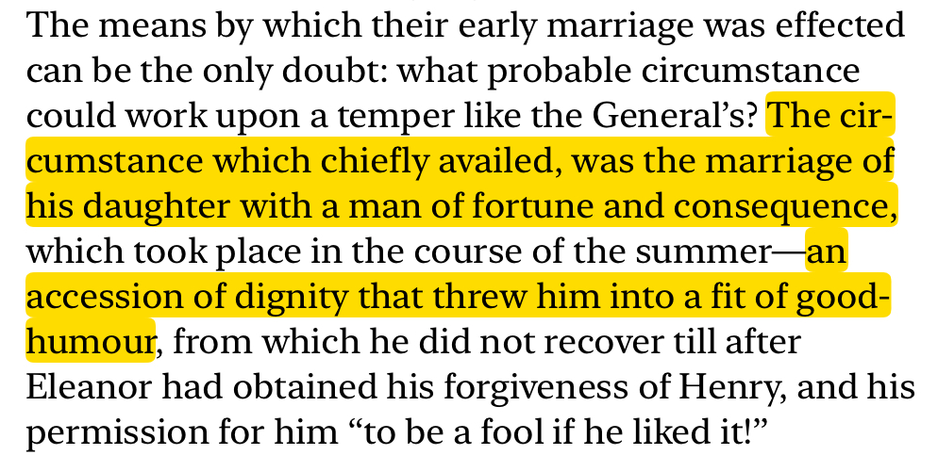
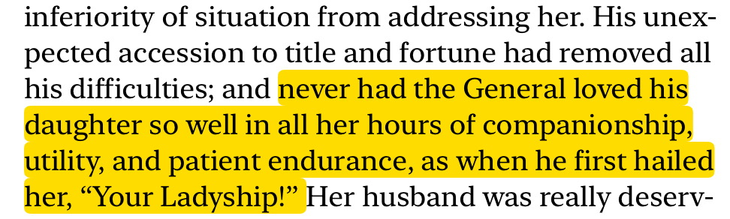
Critique of Marriage Based on Wealth and Status
Dignity comes after a
wealthy marriage
Attitude towards daughter:
“My servant” → “Your Ladyship”
General Tilney

Slide 20
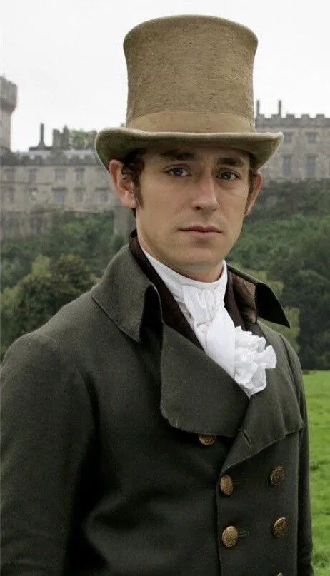
Satire of Men's Egotistical (自我主义的)
Preference for Intellectual Inferiority
Is he compelling? -Yes!
Is he flawless? -No!
Actually serves as a sly（狡猾的） satire.
Henry Tilney

Slide 21
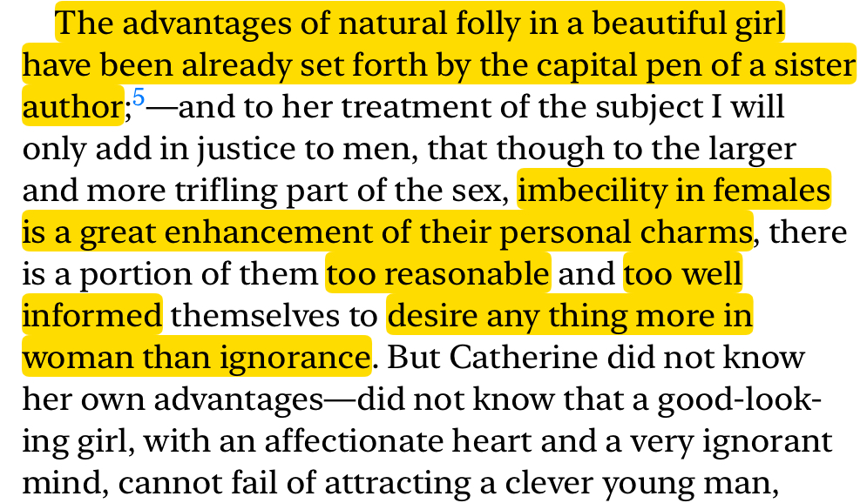
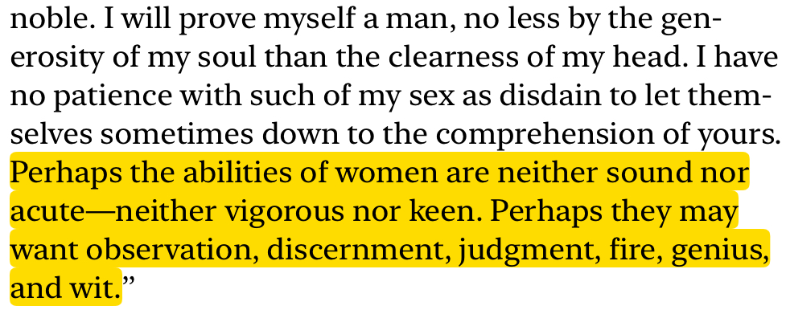
Satire of Men's Egotistical (自我主义的)
Preference for Intellectual Inferiority
Observation:
Societal preference for beautiful women with “stupid” minds
Henry Tilney: “too reasonable” and “too well informed” to desire only ignorance in woman
a sense of superiority

Slide 22
Summary

Slide 23
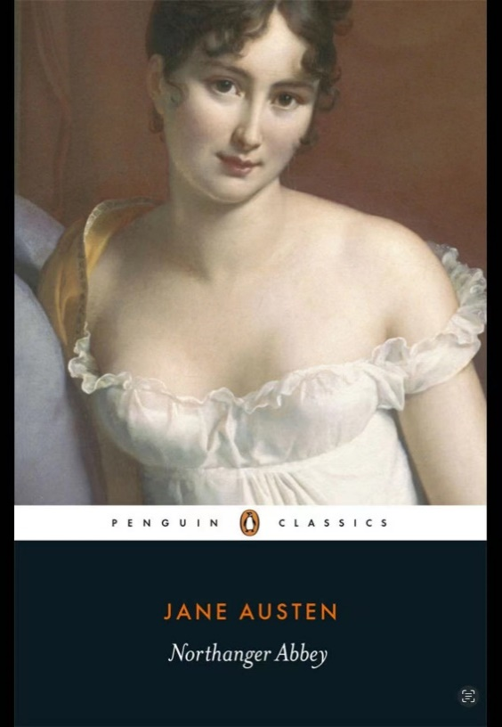
More Direct and Visually Dramatic Approach
Effectively Conveys the Major Themes
Detailed Narrative and Exquisite Character Depictions
Richer Exploration of Themes: Critiques of Social Norms

Slide 24

THANK YOU!

